Slide 1
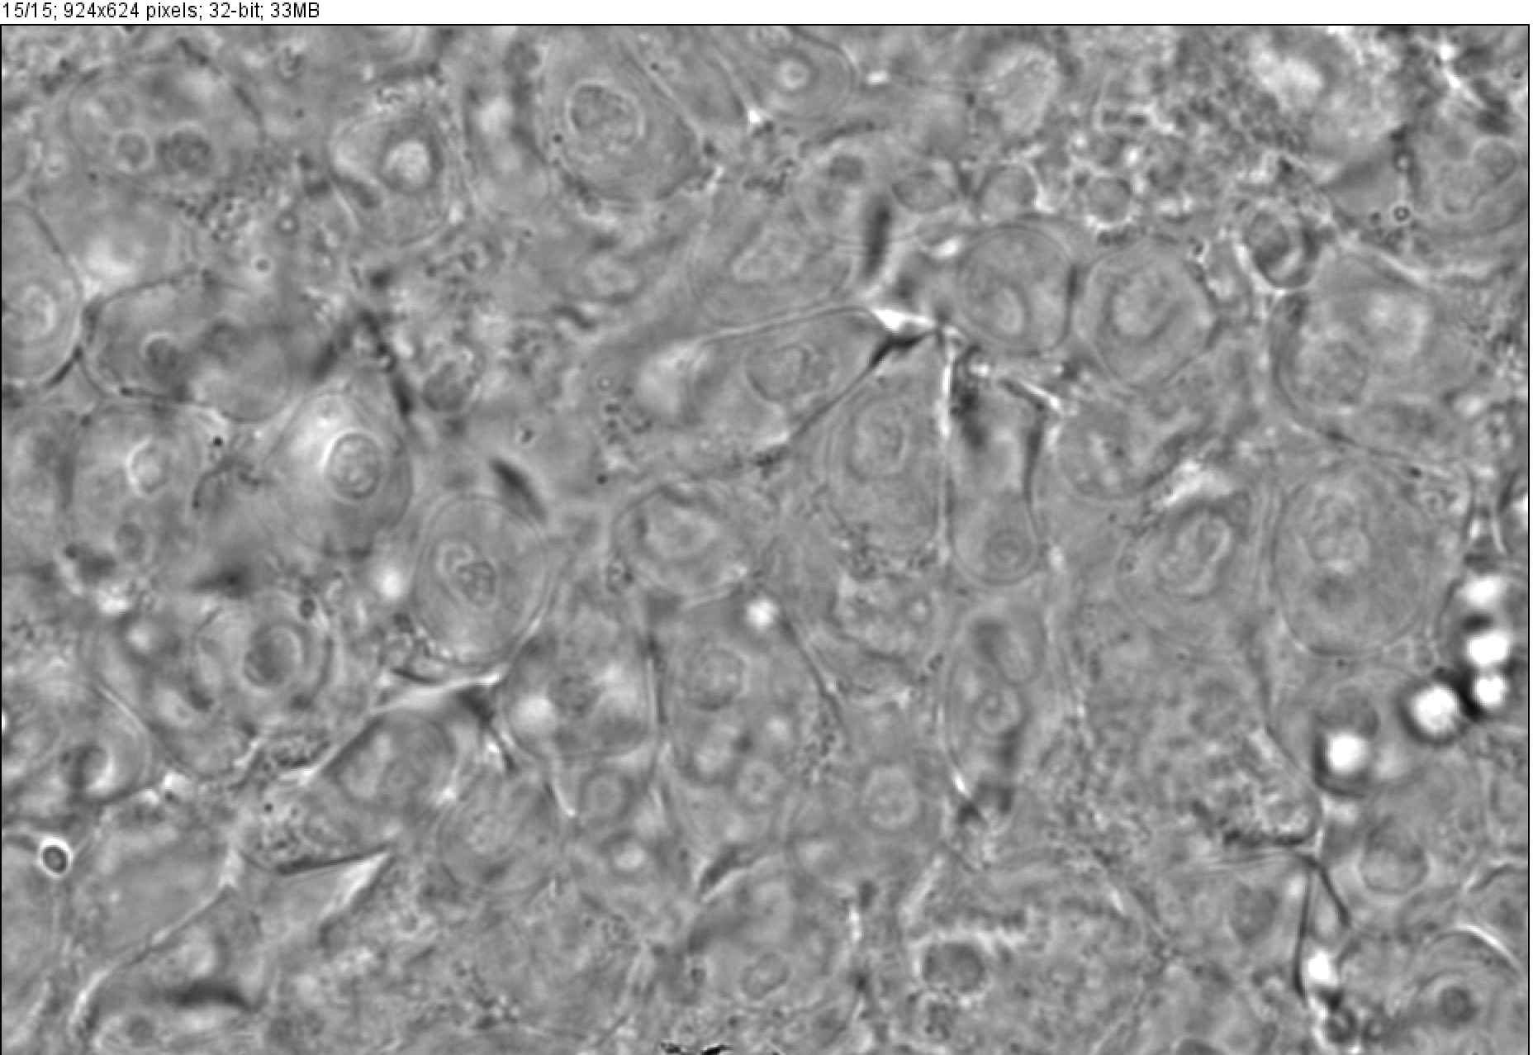
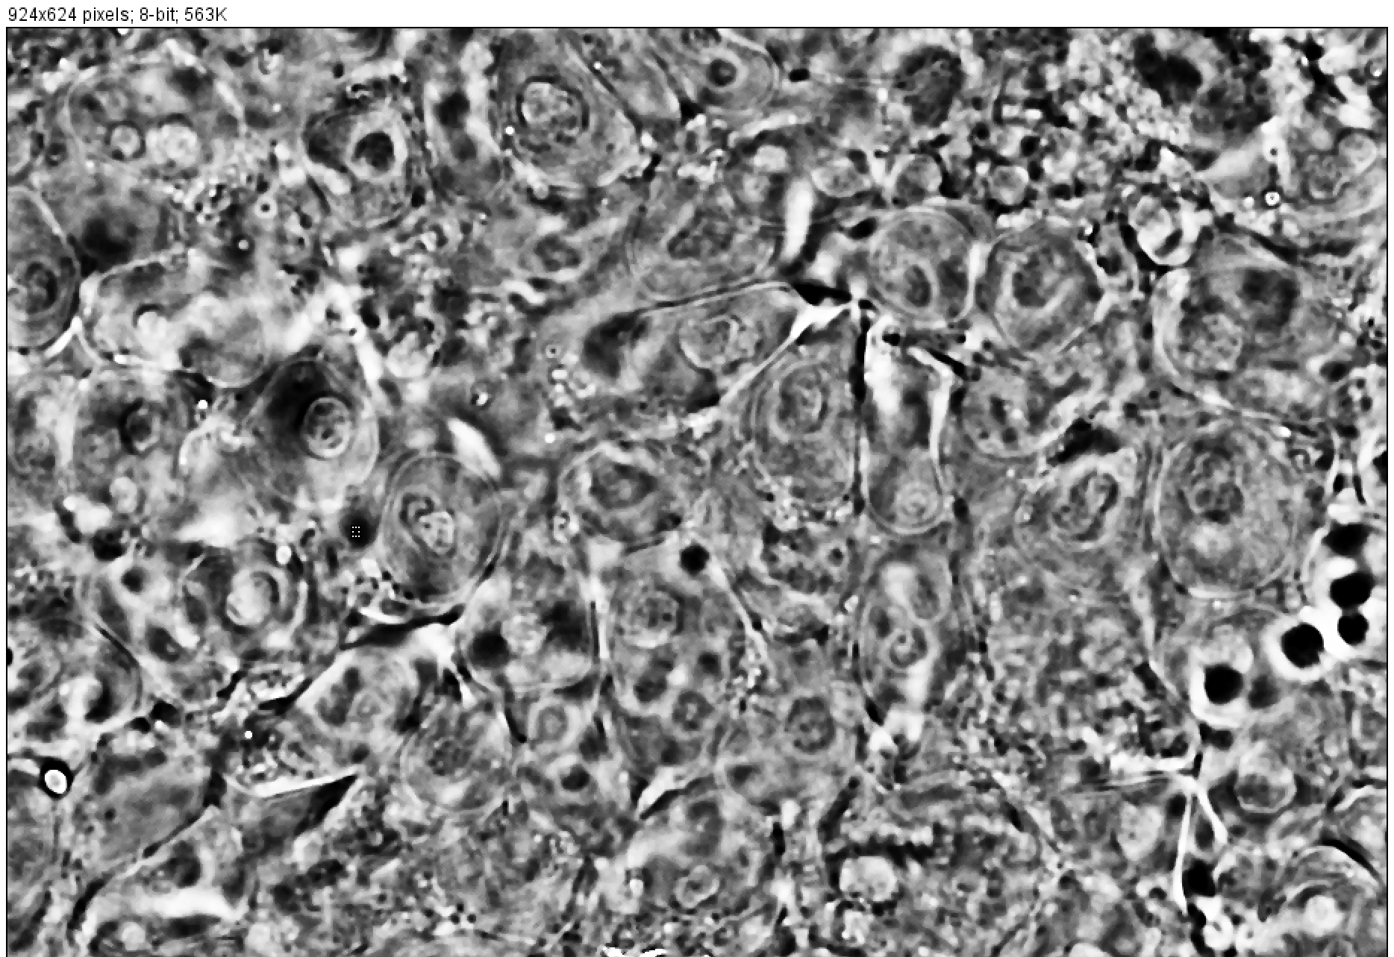
Working with FIJI

Slide 2
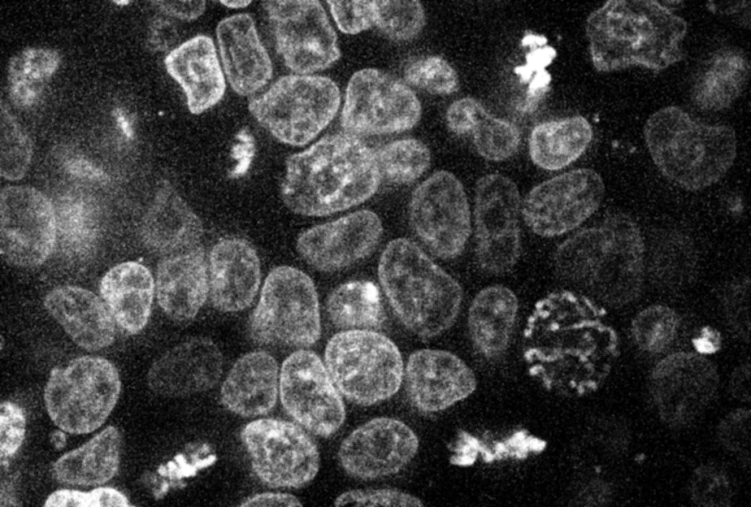
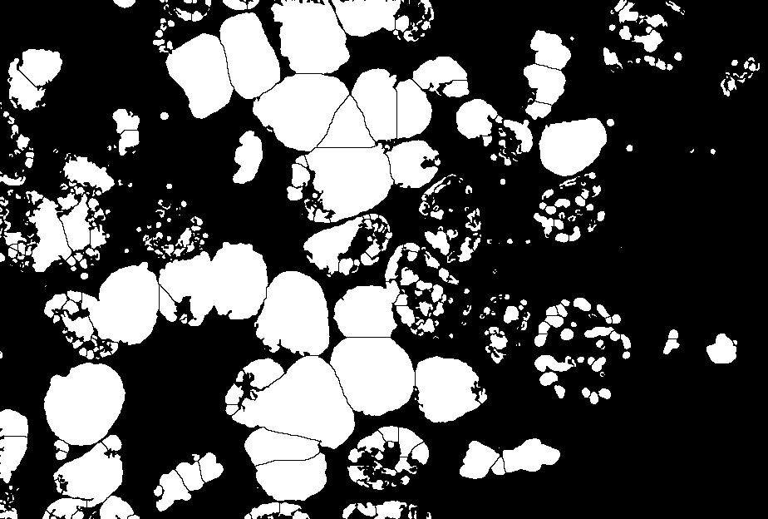
Segmented Image
1.Invert
2.B/W adjust
3.Contrast Enhanced
4.smooth,sharpe
5.Binary mask
6. Watershed
7.Image calculator [add original and mask image]
Target image
(0_prediction image from Moffitt dataset )

Slide 3
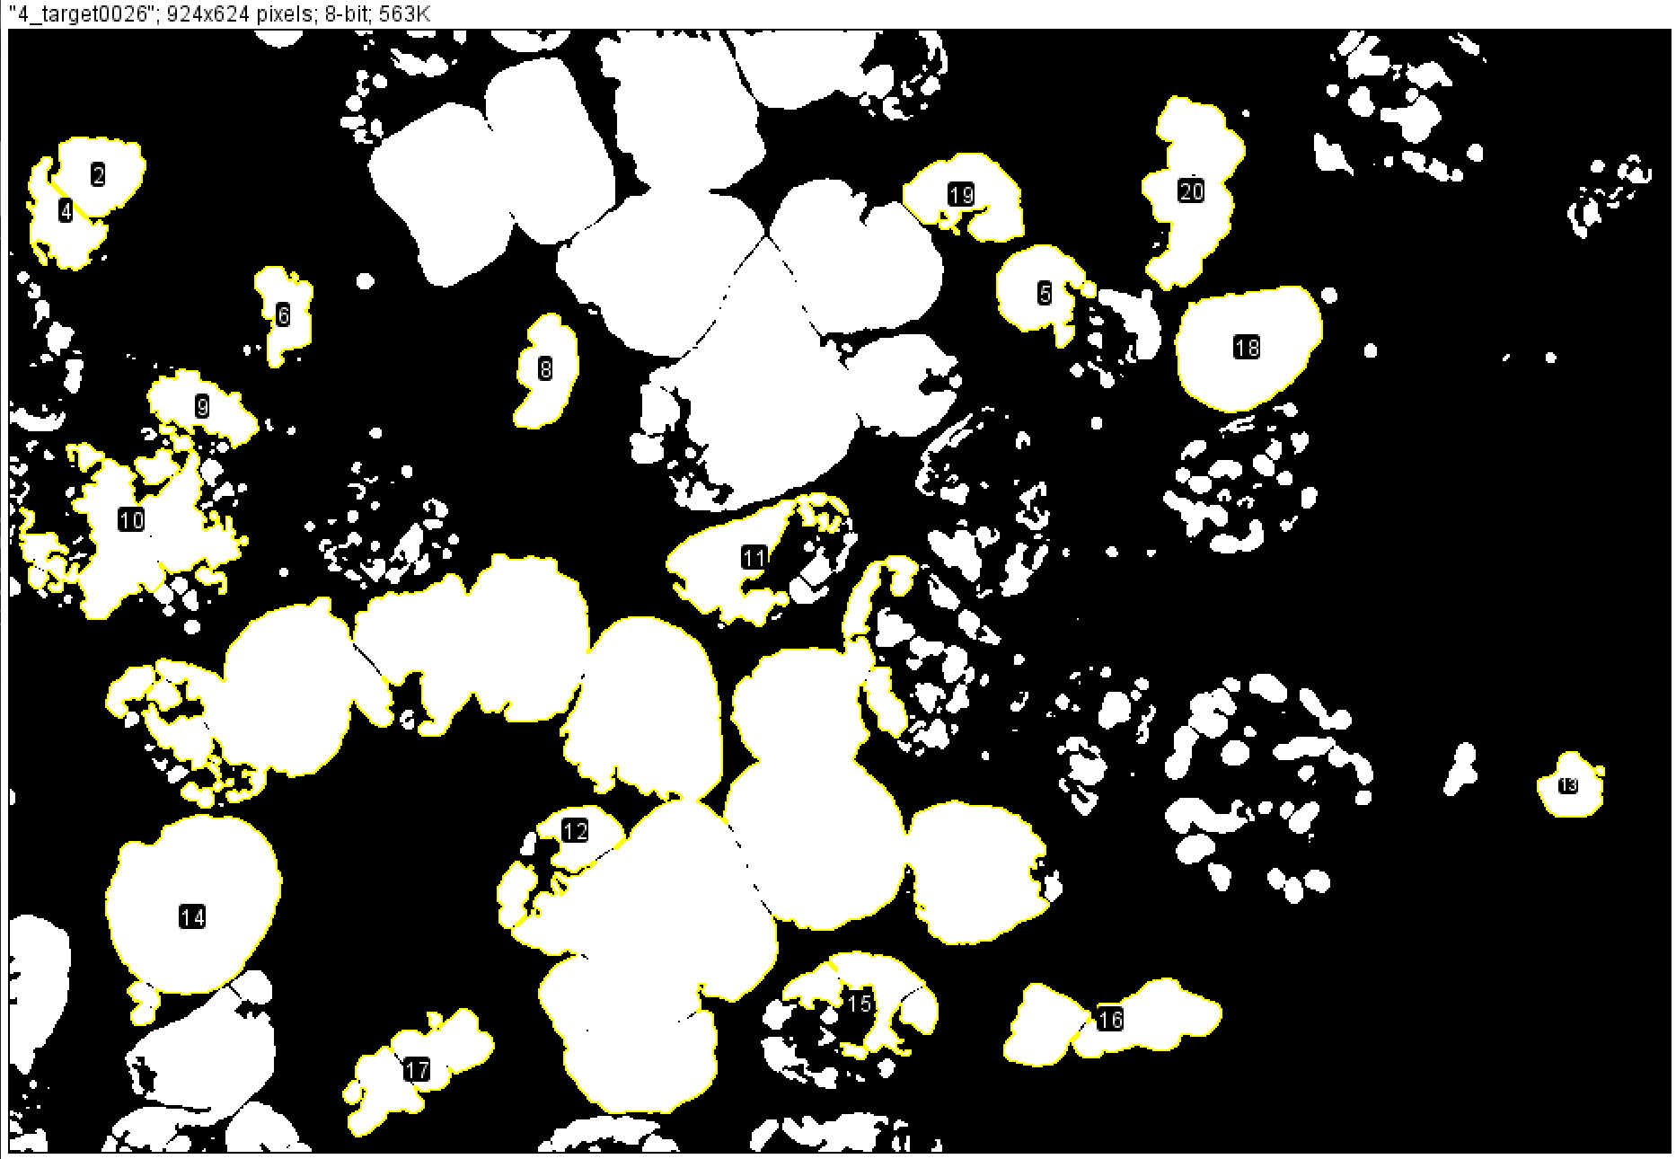
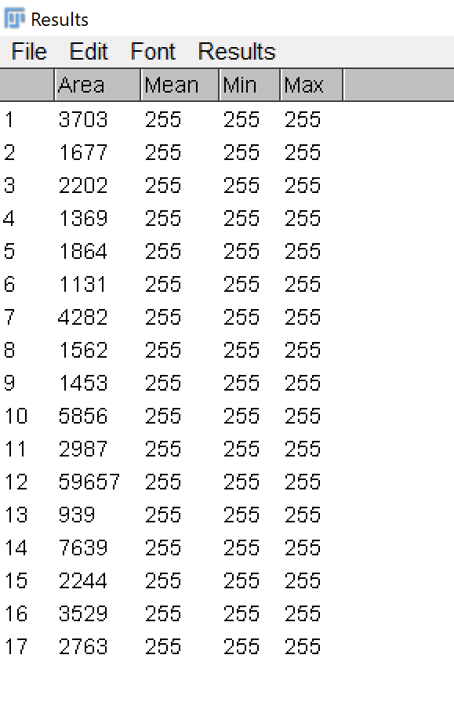
Segmented Image
1.Invert
2.B/W adjust
3.Contrast Enhanced
4.smooth,sharpe
5.Binary mask
6. Watershed
7.Image calculator [add original and mask image]
8.Particle analysis
9. Each particle intensity, area and count

Slide 4
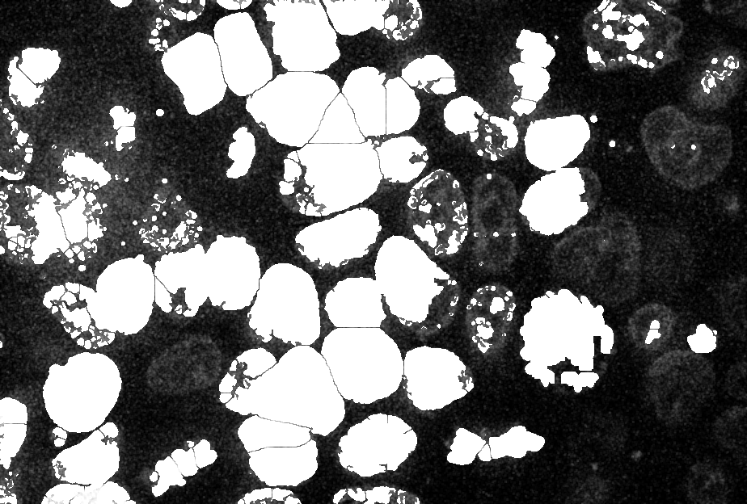
Use the last Segmented Image
Select ROI (cell )
Perform Cell dilution
Fig:3

Slide 6
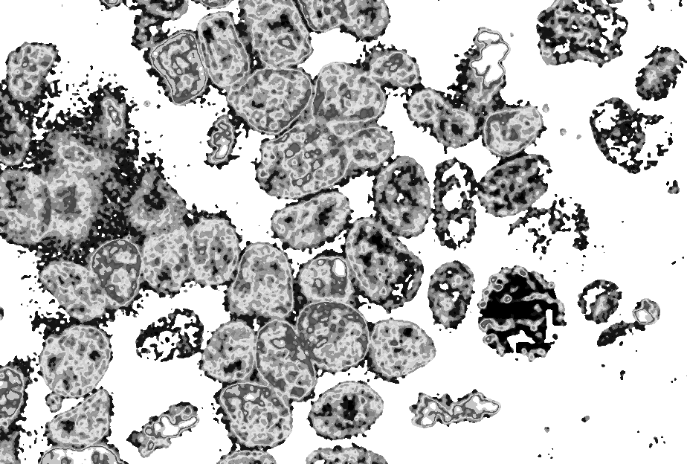
Fig:3, erode, make binary , add with original image
Look up table :16 color

Slide 7
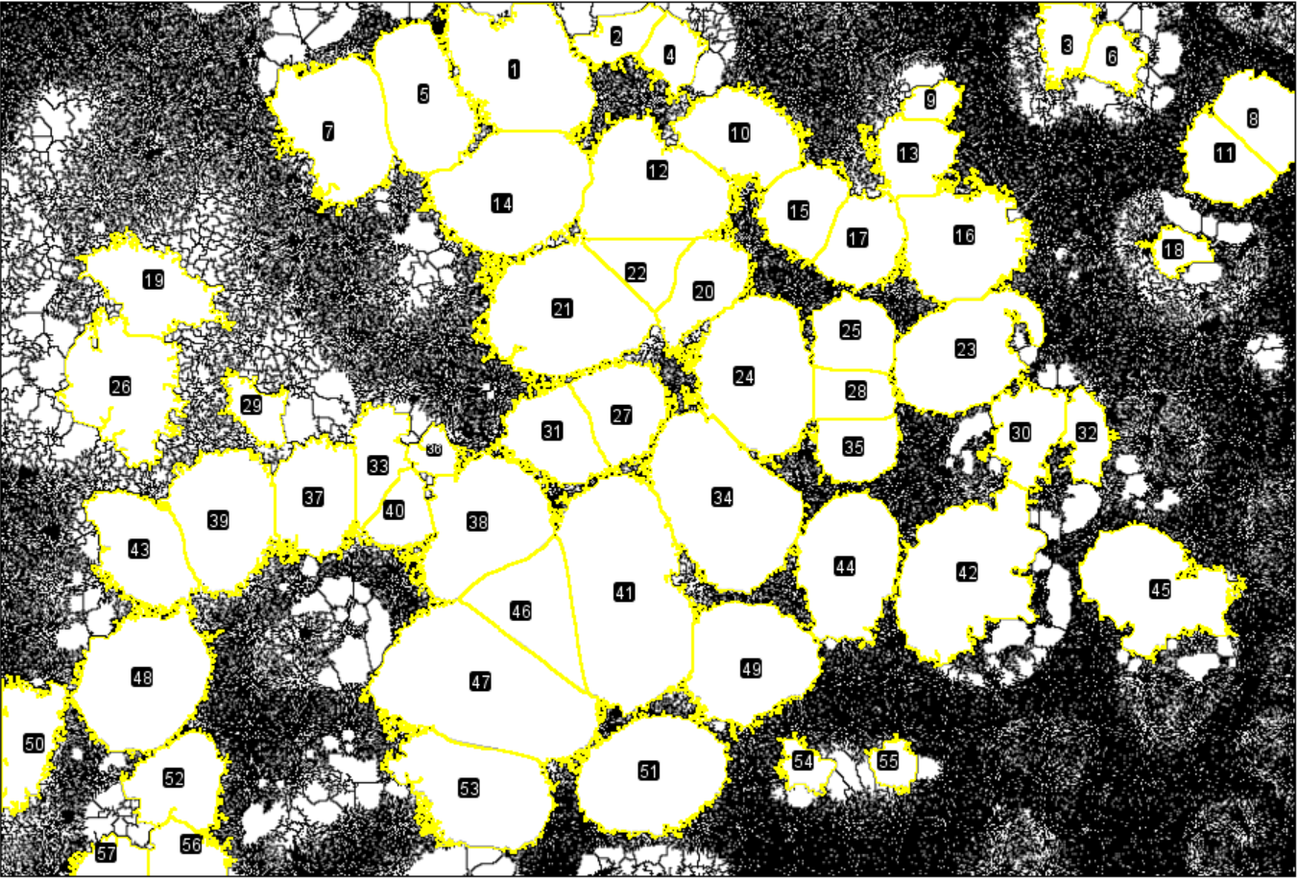

Slide 8
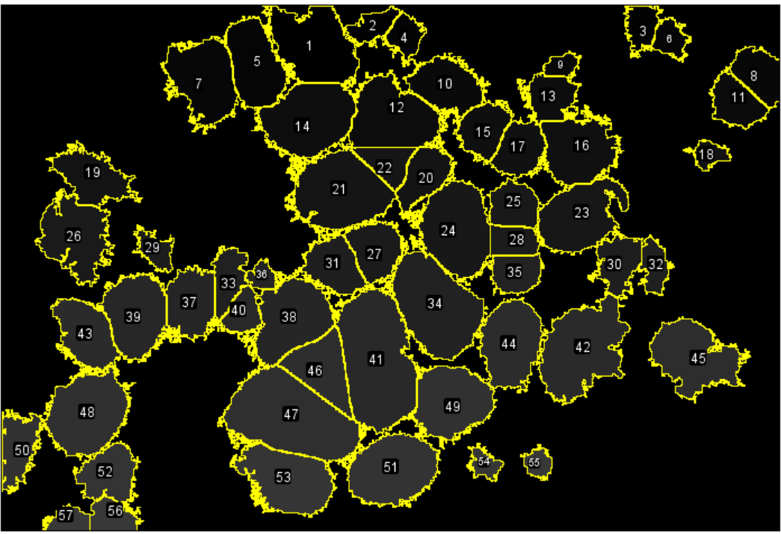
 | Label | Area | Mean | Min | Max | X | Y | XStart | YStart
1 |  | 7273 | 255 | 255 | 255 | 371.089 | 47.148 | 310 | 0
2 |  | 1524 | 255 | 255 | 255 | 440.741 | 24.156 | 463 | 0
3 |  | 1736 | 255 | 255 | 255 | 760.174 | 24.834 | 743 | 0
4 |  | 1613 | 255 | 255 | 255 | 479.327 | 36.312 | 475 | 6
5 |  | 5418 | 255 | 255 | 255 | 301.092 | 69.554 | 286 | 12
6 |  | 1390 | 255 | 255 | 255 | 794.665 | 39.617 | 788 | 14
7 |  | 6354 | 255 | 255 | 255 | 239.555 | 88.41 | 249 | 37
8 |  | 2775 | 255 | 255 | 255 | 899.425 | 81.24 | 888 | 48
9 |  | 871 | 255 | 255 | 255 | 665.565 | 71.05 | 674 | 54
10 |  | 4287 | 255 | 255 | 255 | 528.968 | 94.795 | 533 | 56
11 |  | 2810 | 255 | 255 | 255 | 872.657 | 115.1 | 861 | 72
12 |  | 6997 | 255 | 255 | 255 | 464.439 | 132.301 | 460 | 76
13 |  | 2716 | 255 | 255 | 255 | 651.579 | 108.745 | 640 | 79
14 |  | 7728 | 255 | 255 | 255 | 364.704 | 135.307 | 354 | 91
15 |  | 3026 | 255 | 255 | 255 | 572.754 | 147.13 | 587 | 112
16 |  | 5790 | 255 | 255 | 255 | 685.857 | 171.03 | 693 | 118
17 |  | 3084 | 255 | 255 | 255 | 615.97 | 171.082 | 616 | 133
18 |  | 994 | 255 | 255 | 255 | 841.065 | 177.159 | 833 | 159
19 |  | 4095 | 255 | 255 | 255 | 107.12 | 203.758 | 89 | 160
20 |  | 3100 | 255 | 255 | 255 | 501.936 | 202.589 | 524 | 161
21 |  | 8346 | 255 | 255 | 255 | 401.323 | 221.776 | 410 | 165
22 |  | 2077 | 255 | 255 | 255 | 458.35 | 186.897 | 416 | 169
23 |  | 6333 | 255 | 255 | 255 | 687.515 | 250.111 | 720 | 201
24 |  | 7584 | 255 | 255 | 255 | 539.761 | 265.903 | 537 | 204
25 |  | 2708 | 255 | 255 | 255 | 608.65 | 237.826 | 601 | 205
26 |  | 6030 | 255 | 255 | 255 | 87.338 | 274.793 | 70 | 218
27 |  | 3493 | 255 | 255 | 255 | 444.645 | 290.21 | 444 | 256
28 |  | 1893 | 255 | 255 | 255 | 608.471 | 280.221 | 581 | 260
29 |  | 1377 | 255 | 255 | 255 | 182.371 | 290.594 | 161 | 261
30 |  | 2824 | 255 | 255 | 255 | 733.115 | 306.037 | 733 | 268
31 |  | 3552 | 255 | 255 | 255 | 394.73 | 309.803 | 401 | 270
32 |  | 1629 | 255 | 255 | 255 | 775.59 | 310.111 | 770 | 273
33 |  | 2298 | 255 | 255 | 255 | 269.107 | 324.69 | 261 | 286
34 |  | 9183 | 255 | 255 | 255 | 515.721 | 357.577 | 498 | 288
35 |  | 2347 | 255 | 255 | 255 | 610.99 | 318.133 | 638 | 294
36 |  | 890 | 255 | 255 | 255 | 309.799 | 322.046 | 308 | 300
37 |  | 4133 | 255 | 255 | 255 | 224.932 | 353.819 | 230 | 308
38 |  | 6735 | 255 | 255 | 255 | 343.556 | 372.74 | 349 | 314
39 |  | 5939 | 255 | 255 | 255 | 159.578 | 367.487 | 161 | 318
40 |  | 1780 | 255 | 255 | 255 | 286.17 | 366.015 | 291 | 333
41 |  | 11927 | 255 | 255 | 255 | 446.223 | 421.873 | 451 | 335
42 |  | 8665 | 255 | 255 | 255 | 689.981 | 408.699 | 717 | 342
43 |  | 4482 | 255 | 255 | 255 | 99.745 | 390.506 | 83 | 347
44 |  | 6014 | 255 | 255 | 255 | 605.286 | 401.901 | 618 | 347
45 |  | 6493 | 255 | 255 | 255 | 822.709 | 418.107 | 809 | 370
46 |  | 4451 | 255 | 255 | 255 | 380.662 | 432.735 | 395 | 381
47 |  | 11605 | 255 | 255 | 255 | 342.56 | 490.117 | 325 | 427
48 |  | 7441 | 255 | 255 | 255 | 101.631 | 484.438 | 127 | 428
49 |  | 6338 | 255 | 255 | 255 | 534.395 | 471.041 | 514 | 428
50 |  | 3099 | 255 | 255 | 255 | 19.157 | 525.667 | 4 | 480
51 |  | 7053 | 255 | 255 | 255 | 464.661 | 551.992 | 499 | 505
52 |  | 3546 | 255 | 255 | 255 | 127.283 | 557.322 | 141 | 518
53 |  | 6714 | 255 | 255 | 255 | 338.722 | 563.757 | 304 | 518
54 |  | 945 | 255 | 255 | 255 | 573.71 | 545.339 | 565 | 521
55 |  | 923 | 255 | 255 | 255 | 637.852 | 544.09 | 637 | 522
56 |  | 1757 | 255 | 255 | 255 | 131.253 | 607.583 | 121 | 582
57 |  | 1155 | 255 | 255 | 255 | 79.627 | 612.206 | 79 | 593
58 | Mean | 4339.298 | 255 | 255 | 255 | 459.576 | 290.798 | 456.754 | 249.526
59 | SD | 2775.886 | 0 | 0 | 0 | 230.742 | 168.66 | 232.825 | 166.861
60 | Min | 871 | 255 | 255 | 255 | 19.157 | 24.156 | 4 | 0
61 | Max | 11927 | 255 | 255 | 255 | 899.425 | 612.206 | 888 | 593

Slide 9
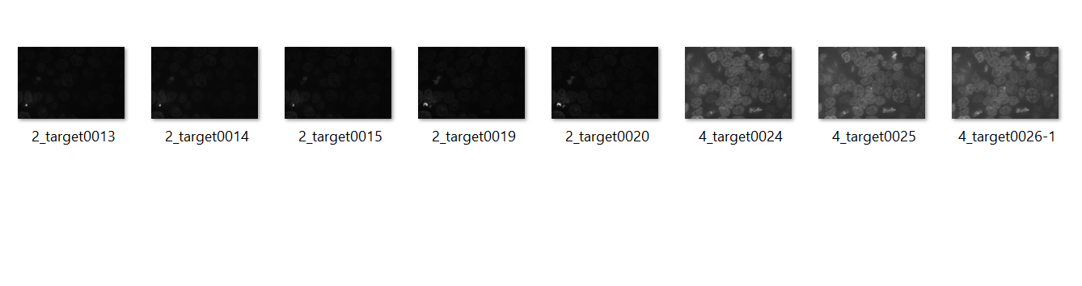
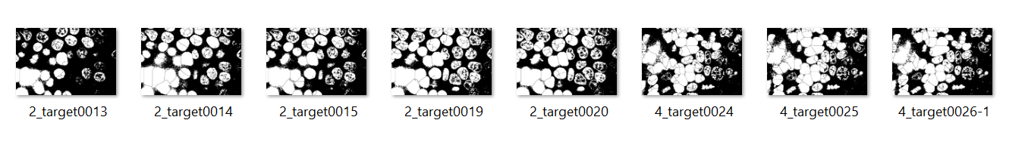
Batch processing using ImageJ Macro:8-bit image

Slide 10
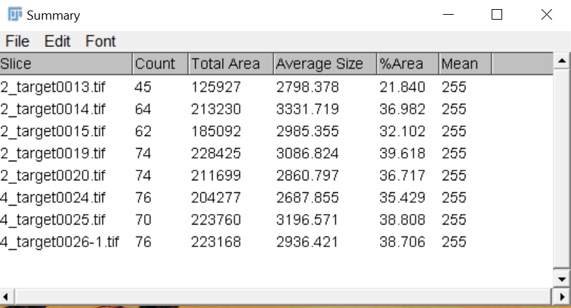
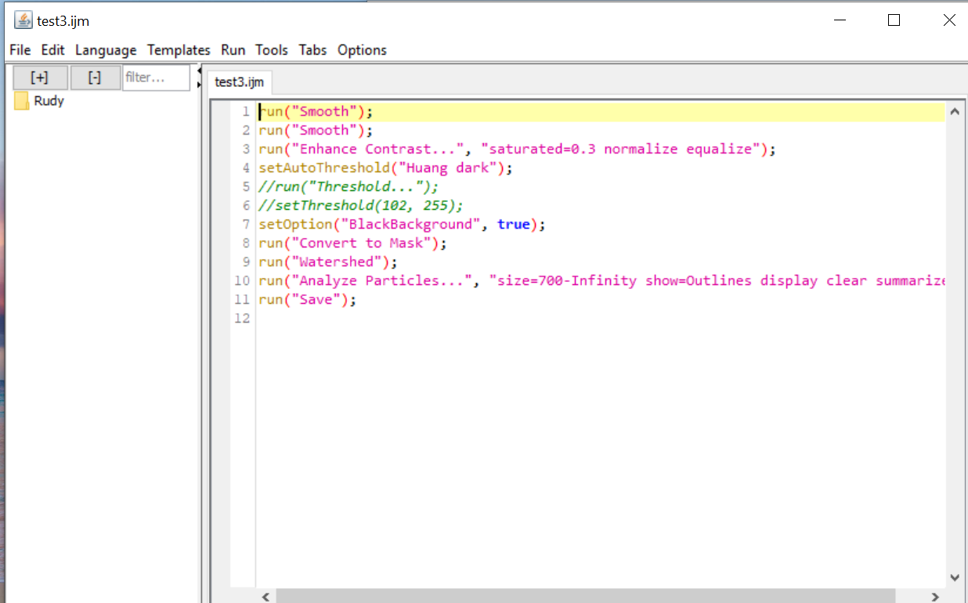
Cell coordinates, area
 | Area | Mean | Min | Max | X | Y
1 | 721 | 255 | 255 | 255 | 211.317 | 15.241
2 | 2261 | 255 | 255 | 255 | 361.963 | 14.879
3 | 718 | 255 | 255 | 255 | 415.519 | 12.564
4 | 4353 | 255 | 255 | 255 | 474.907 | 24.003
5 | 4692 | 255 | 255 | 255 | 374.378 | 57.945
6 | 740 | 255 | 255 | 255 | 754.565 | 43.545
7 | 3955 | 255 | 255 | 255 | 307.291 | 74.924
8 | 1530 | 255 | 255 | 255 | 660.592 | 60.289
9 | 6383 | 255 | 255 | 255 | 244.818 | 87.986
10 | 4311 | 255 | 255 | 255 | 39.371 | 96.426
11 | 3063 | 255 | 255 | 255 | 529.349 | 91.727
12 | 727 | 255 | 255 | 255 | 897.794 | 76.629
13 | 2036 | 255 | 255 | 255 | 651.641 | 98.576
14 | 1359 | 255 | 255 | 255 | 876.365 | 111.011
15 | 7522 | 255 | 255 | 255 | 461.999 | 128.674
16 | 5841 | 255 | 255 | 255 | 372.417 | 133.651
17 | 1782 | 255 | 255 | 255 | 324.664 | 128.781
18 | 3278 | 255 | 255 | 255 | 146.604 | 162.396
19 | 1336 | 255 | 255 | 255 | 645.478 | 133.254
20 | 2426 | 255 | 255 | 255 | 575.778 | 144.532
21 | 4691 | 255 | 255 | 255 | 686.74 | 174.032
22 | 1518 | 255 | 255 | 255 | 623.587 | 164.665
23 | 782 | 255 | 255 | 255 | 20.512 | 164.973
24 | 1276 | 255 | 255 | 255 | 300.857 | 179.31
25 | 13329 | 255 | 255 | 255 | 436.737 | 209.796
26 | 17206 | 255 | 255 | 255 | 86.294 | 261.475
27 | 935 | 255 | 255 | 255 | 26.497 | 188.629
28 | 1183 | 255 | 255 | 255 | 12.579 | 249.861
29 | 1378 | 255 | 255 | 255 | 690.097 | 248.046
30 | 4484 | 255 | 255 | 255 | 222.797 | 307.577
31 | 1511 | 255 | 255 | 255 | 563.279 | 270.913
32 | 725 | 255 | 255 | 255 | 451.805 | 269.154
33 | 4157 | 255 | 255 | 255 | 405.645 | 301.277
34 | 1667 | 255 | 255 | 255 | 186.07 | 291.182
35 | 955 | 255 | 255 | 255 | 525.029 | 284.607
36 | 979 | 255 | 255 | 255 | 452.931 | 297.992
37 | 6605 | 255 | 255 | 255 | 272.218 | 338.689
38 | 918 | 255 | 255 | 255 | 500.546 | 305.368
39 | 938 | 255 | 255 | 255 | 549.301 | 305.753
40 | 1345 | 255 | 255 | 255 | 482.093 | 328.881
41 | 7697 | 255 | 255 | 255 | 157.337 | 364.501
42 | 1872 | 255 | 255 | 255 | 525.632 | 353.604
43 | 8752 | 255 | 255 | 255 | 348.609 | 381.494
44 | 4917 | 255 | 255 | 255 | 443.452 | 374.936
45 | 1563 | 255 | 255 | 255 | 76.045 | 365.045
46 | 1318 | 255 | 255 | 255 | 620.127 | 376.369
47 | 1661 | 255 | 255 | 255 | 503.523 | 384.585
48 | 2697 | 255 | 255 | 255 | 105.905 | 405.461
49 | 1564 | 255 | 255 | 255 | 595.652 | 412.365
50 | 910 | 255 | 255 | 255 | 808.663 | 415.056
51 | 959 | 255 | 255 | 255 | 869.973 | 420.399
52 | 7419 | 255 | 255 | 255 | 449.614 | 450.595
53 | 3838 | 255 | 255 | 255 | 304.226 | 469.033
54 | 7350 | 255 | 255 | 255 | 379.442 | 484.547
55 | 1695 | 255 | 255 | 255 | 521.158 | 448.667
56 | 3484 | 255 | 255 | 255 | 102.508 | 459.97
57 | 1602 | 255 | 255 | 255 | 564.24 | 465.161
58 | 2159 | 255 | 255 | 255 | 527.155 | 488.142
59 | 2113 | 255 | 255 | 255 | 117.057 | 507.206
60 | 727 | 255 | 255 | 255 | 94.526 | 490.77
61 | 884 | 255 | 255 | 255 | 68.84 | 503.037
62 | 2873 | 255 | 255 | 255 | 16.548 | 530.679
63 | 7887 | 255 | 255 | 255 | 341.398 | 553.053
64 | 2426 | 255 | 255 | 255 | 488.883 | 545.371
65 | 823 | 255 | 255 | 255 | 449.992 | 533.54
66 | 2580 | 255 | 255 | 255 | 125.651 | 555.554
67 | 1642 | 255 | 255 | 255 | 641.613 | 547.767
68 | 1336 | 255 | 255 | 255 | 572.188 | 553.356
69 | 874 | 255 | 255 | 255 | 603.156 | 552.403
70 | 1563 | 255 | 255 | 255 | 439.723 | 569.875
71 | 1104 | 255 | 255 | 255 | 247.831 | 559.254
72 | 4594 | 255 | 255 | 255 | 103.345 | 599.521
73 | 1578 | 255 | 255 | 255 | 201.48 | 590.619
74 | 1055 | 255 | 255 | 255 | 13.145 | 603.157
75 | 767 | 255 | 255 | 255 | 469.062 | 611.951
76 | 1269 | 255 | 255 | 255 | 332.564 | 615.175

Slide 11
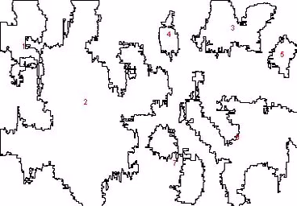
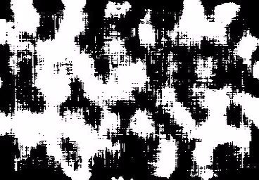
Segmentation on the entire virtual stack (11 slides)

Slide 12
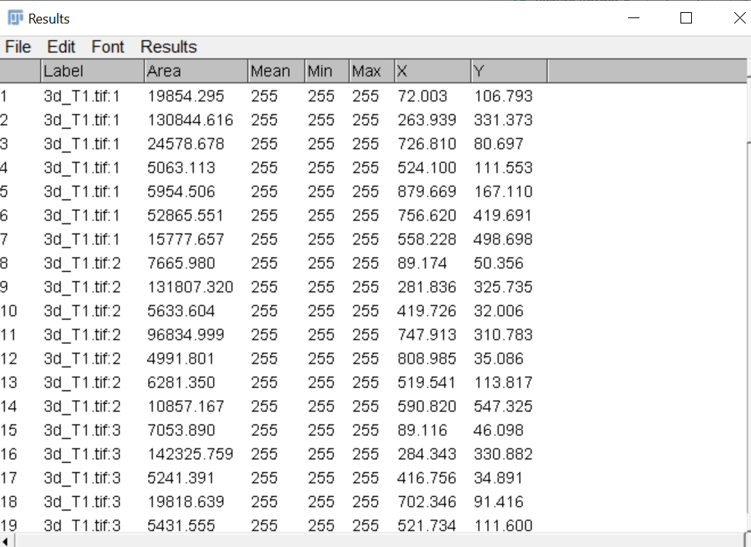
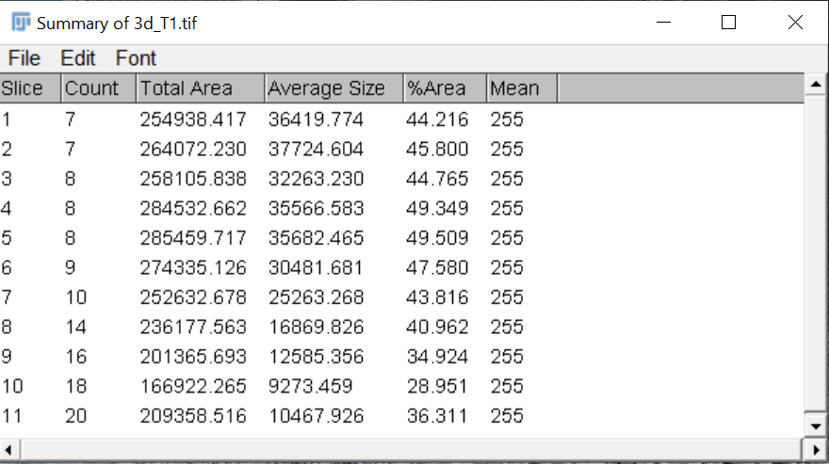

Slide 13
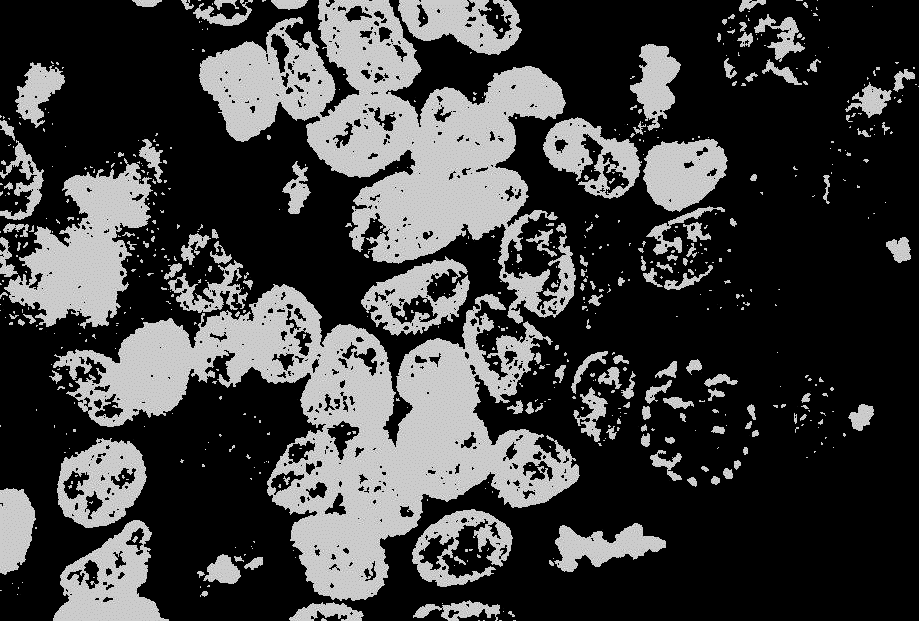
3D segmentation using FIJI
Feedback issues:
Some images don’t load properly
Not enough resources for on 3D segmenting with fiji
Try to downgrade the image size

Slide 14
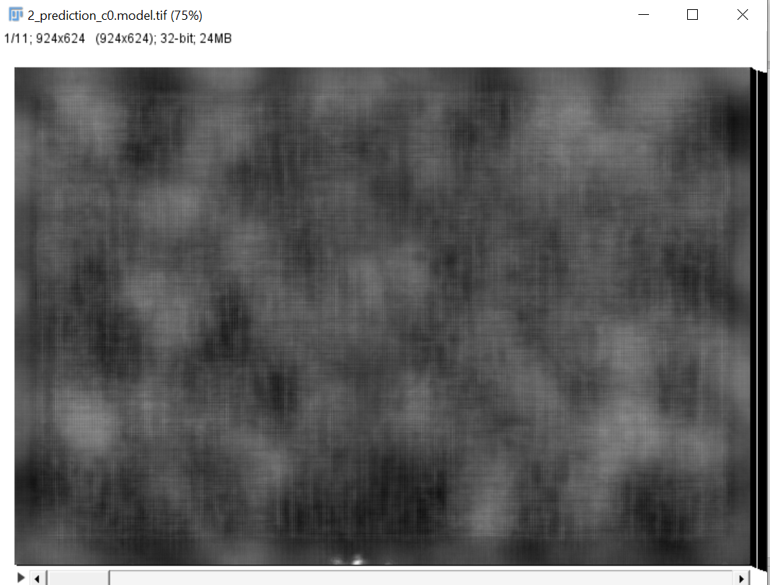
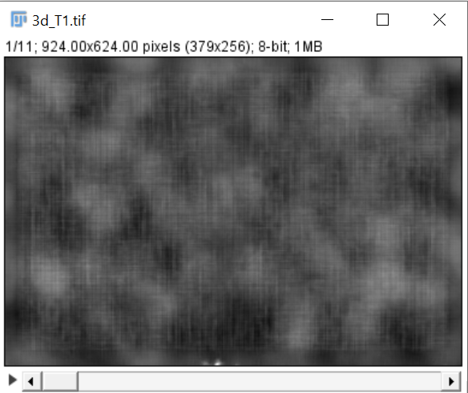
3D object segmentation
File name: 0_prediction_c0.model original
size: 924 x 624 ,32 bit (24 MB) image
File name: 0_prediction_c0.model original
Size: 379 x 256 , 8-bit (1MB) image

Slide 15
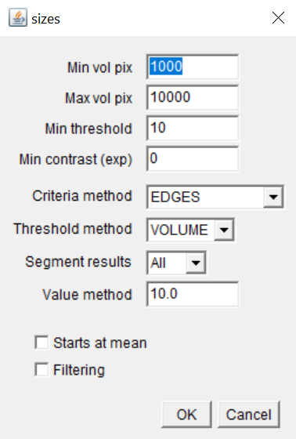
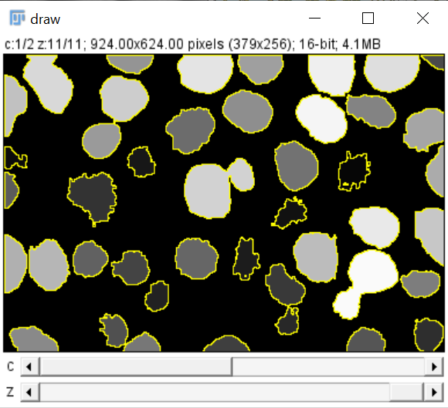
3D thresholding

Slide 16
